Slide 1

W209 Final Presentation
Explore And Visualize Educational Opportunities for Women
Charlene Chen
Divya Babu
Matt Thielen
Nate Velarde

Slide 2


Overview
Context:
Women face barriers to education caused by poverty, cultural norms, poor infrastructure, violence and political instability. Better educated women lead to broad national benefits.
Goal:
Our goal is to enable users to efficiently discover, compare and explore educational opportunities for women around the world.
Notes:
Around the world, women face barriers to education caused by poverty, cultural norms, poor infrastructure, violence and political instability. Better educated women tend to be healthier, participate more in the formal labor market, earn higher incomes, have fewer children, marry at a later age, and enable better health care and education for their children. All these factors combined can improve the lives of a nation’s citizens.
Our goal is to enable users to efficiently discover, compare and explore educational opportunities for women around the world and aid in the iterative cycle of data exploration, hypotheses generation, testing and insights that ultimately lead to policies that eliminate the education gender gap.

Slide 3


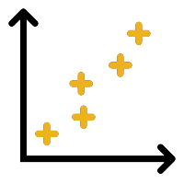

Data / Users / Tasks
Data: Our project utilizes the World Bank EdStats’ country-level enrollment statistics as a proxy for educational opportunities by gender at the primary, secondary and tertiary education levels.
Users: Policy analysts, government education/development officials and NGOs concerned with gender equality issues in education.
Tasks:
Present an Overview Dashboard
Discover distributions of education indicators among countries and regions
Explore relationships between country education indicators and key macroeconomic and demographic measures
Compare trends of key education indicators and key macroeconomic and demographic measures
Summary Detail
Notes:
The World Bank EdStats All Indicator Query dataset holds around 4,000 internationally comparable features that describe education access, progression, completion, literacy, teachers, population, and expenditures. EdStats covers over 200 countries dating back to 1970.

Slide 4
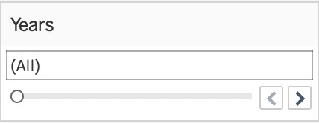
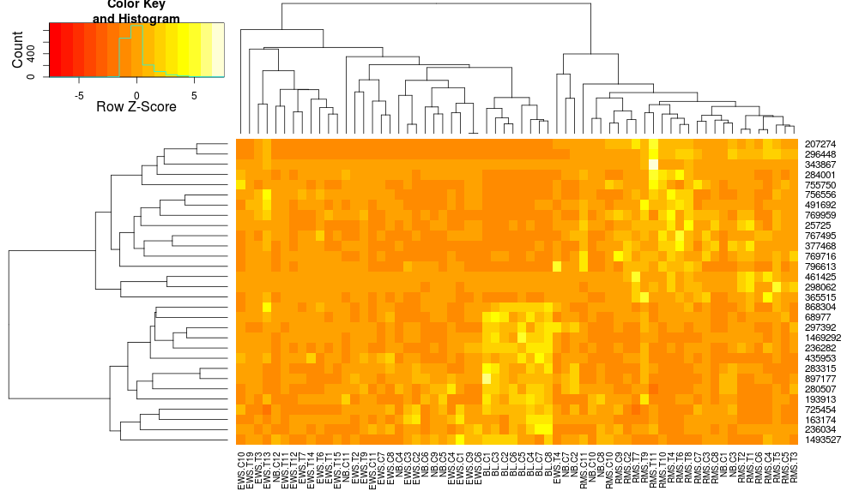
Task 1 - Overview
Heatmap overview
Features
When mouse over, show the name of feature, feature group, country, and period involved.
Countries
Narrow down to few metrics
for gender equality issues
in education
Get rid of the heatmap
of midterm presentation
Features/indicators
Group*

Slide 5
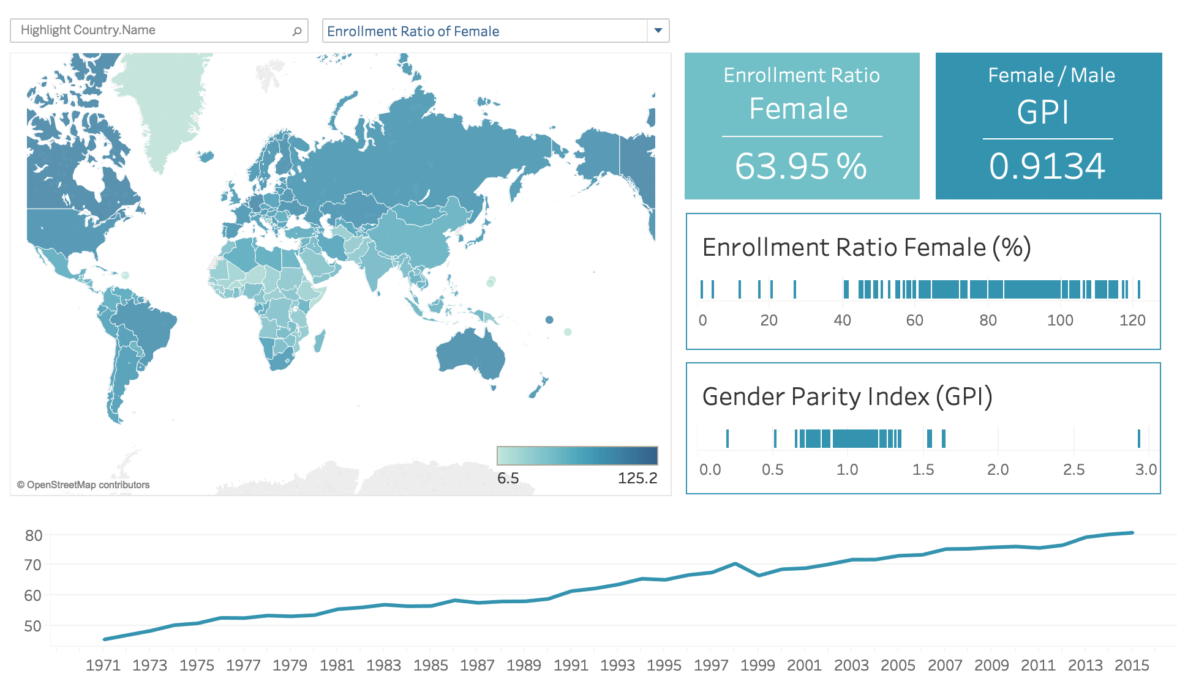
Task 1 - Dashboard Overview
Present a dashboard overview of two key index, the Enrollment Rate of Female and the Gender Parity Index (GPI) by country and by time.
Then users are able to hover and select interesting index, countries, or years to see the subset overview.

Slide 6
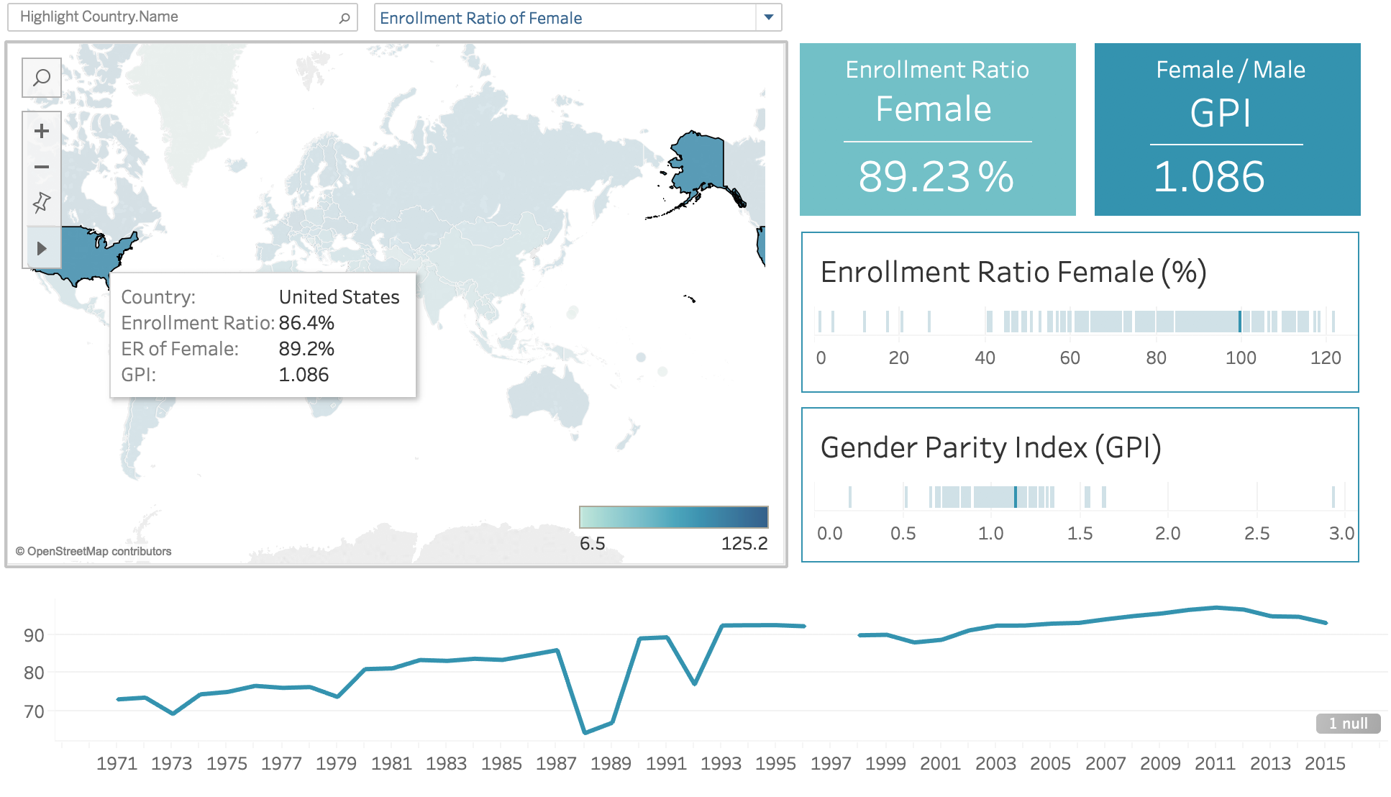
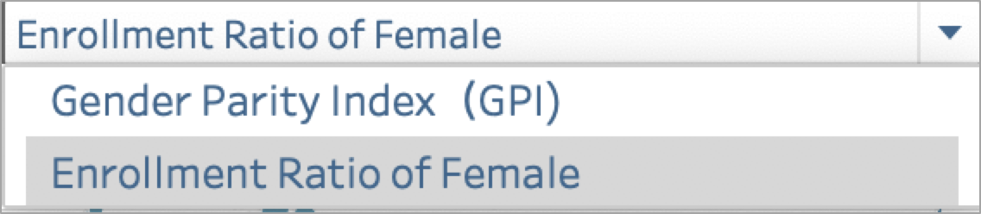

Task 1 - Overview by Selected Countries
Select key index
Aggregated index value
Hover over selected country
Highlighted Index value of that country among other countries
Index trend and data availability of that country through years.

Slide 7
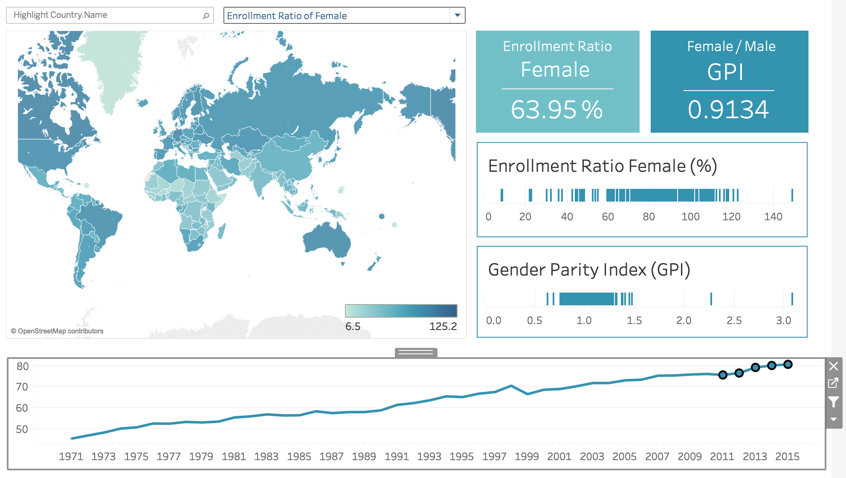
Task 1 - Overview by Selected Years
Aggregated index value
Global map of selected years
Index value of that country among other countries
Select or Hover over years interested

Slide 8
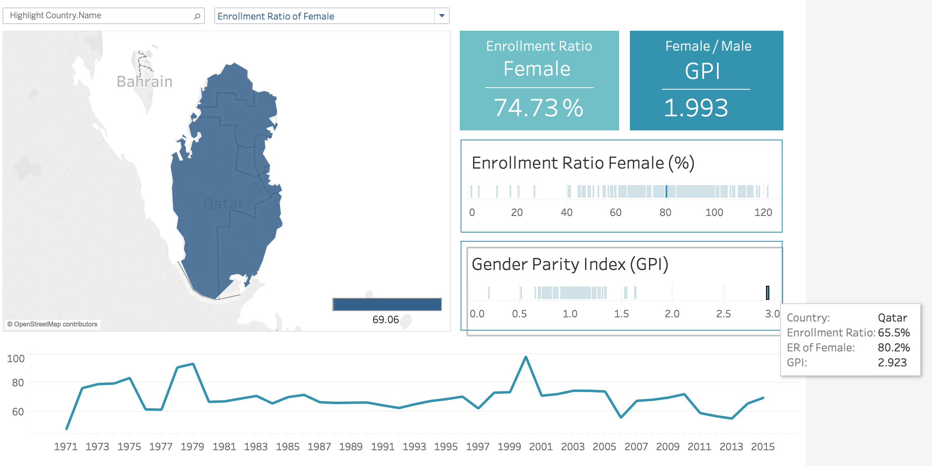
Task 1 - Overview by Outliers
Aggregated index value
Map of that country
Hover over outliers
Index trend and data availability of that outlier country through years.

Slide 9
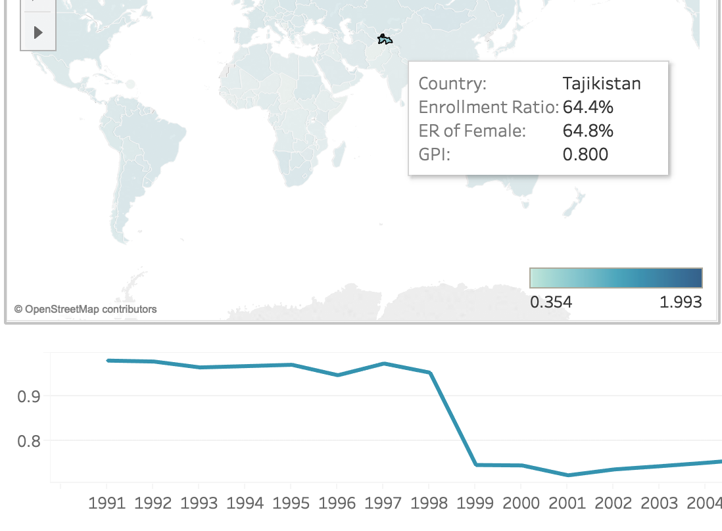
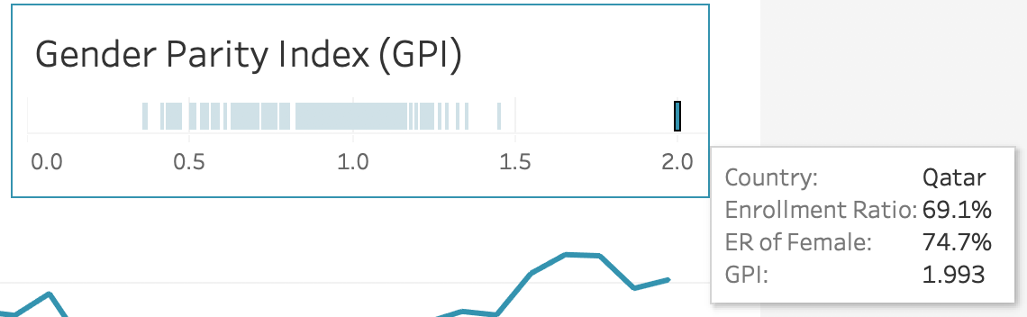
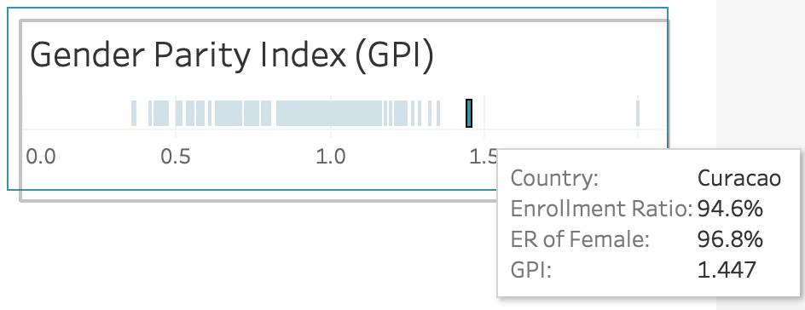
Task 1 - Example of Interesting Insights
Overall trends: GPI and enrollment ratio of female is steadily going up by time, indicating more and more women get the opportunity to receive education.
There are some outliers, for example, the GPI of Tajikistan decrease from above 0.9 to below 0.8 in the year of 1998 because of the Civil War.
Outliers: Qatar has far higher GPI (1.997) than that of the second highest country Curacao (1.447) .

Slide 10
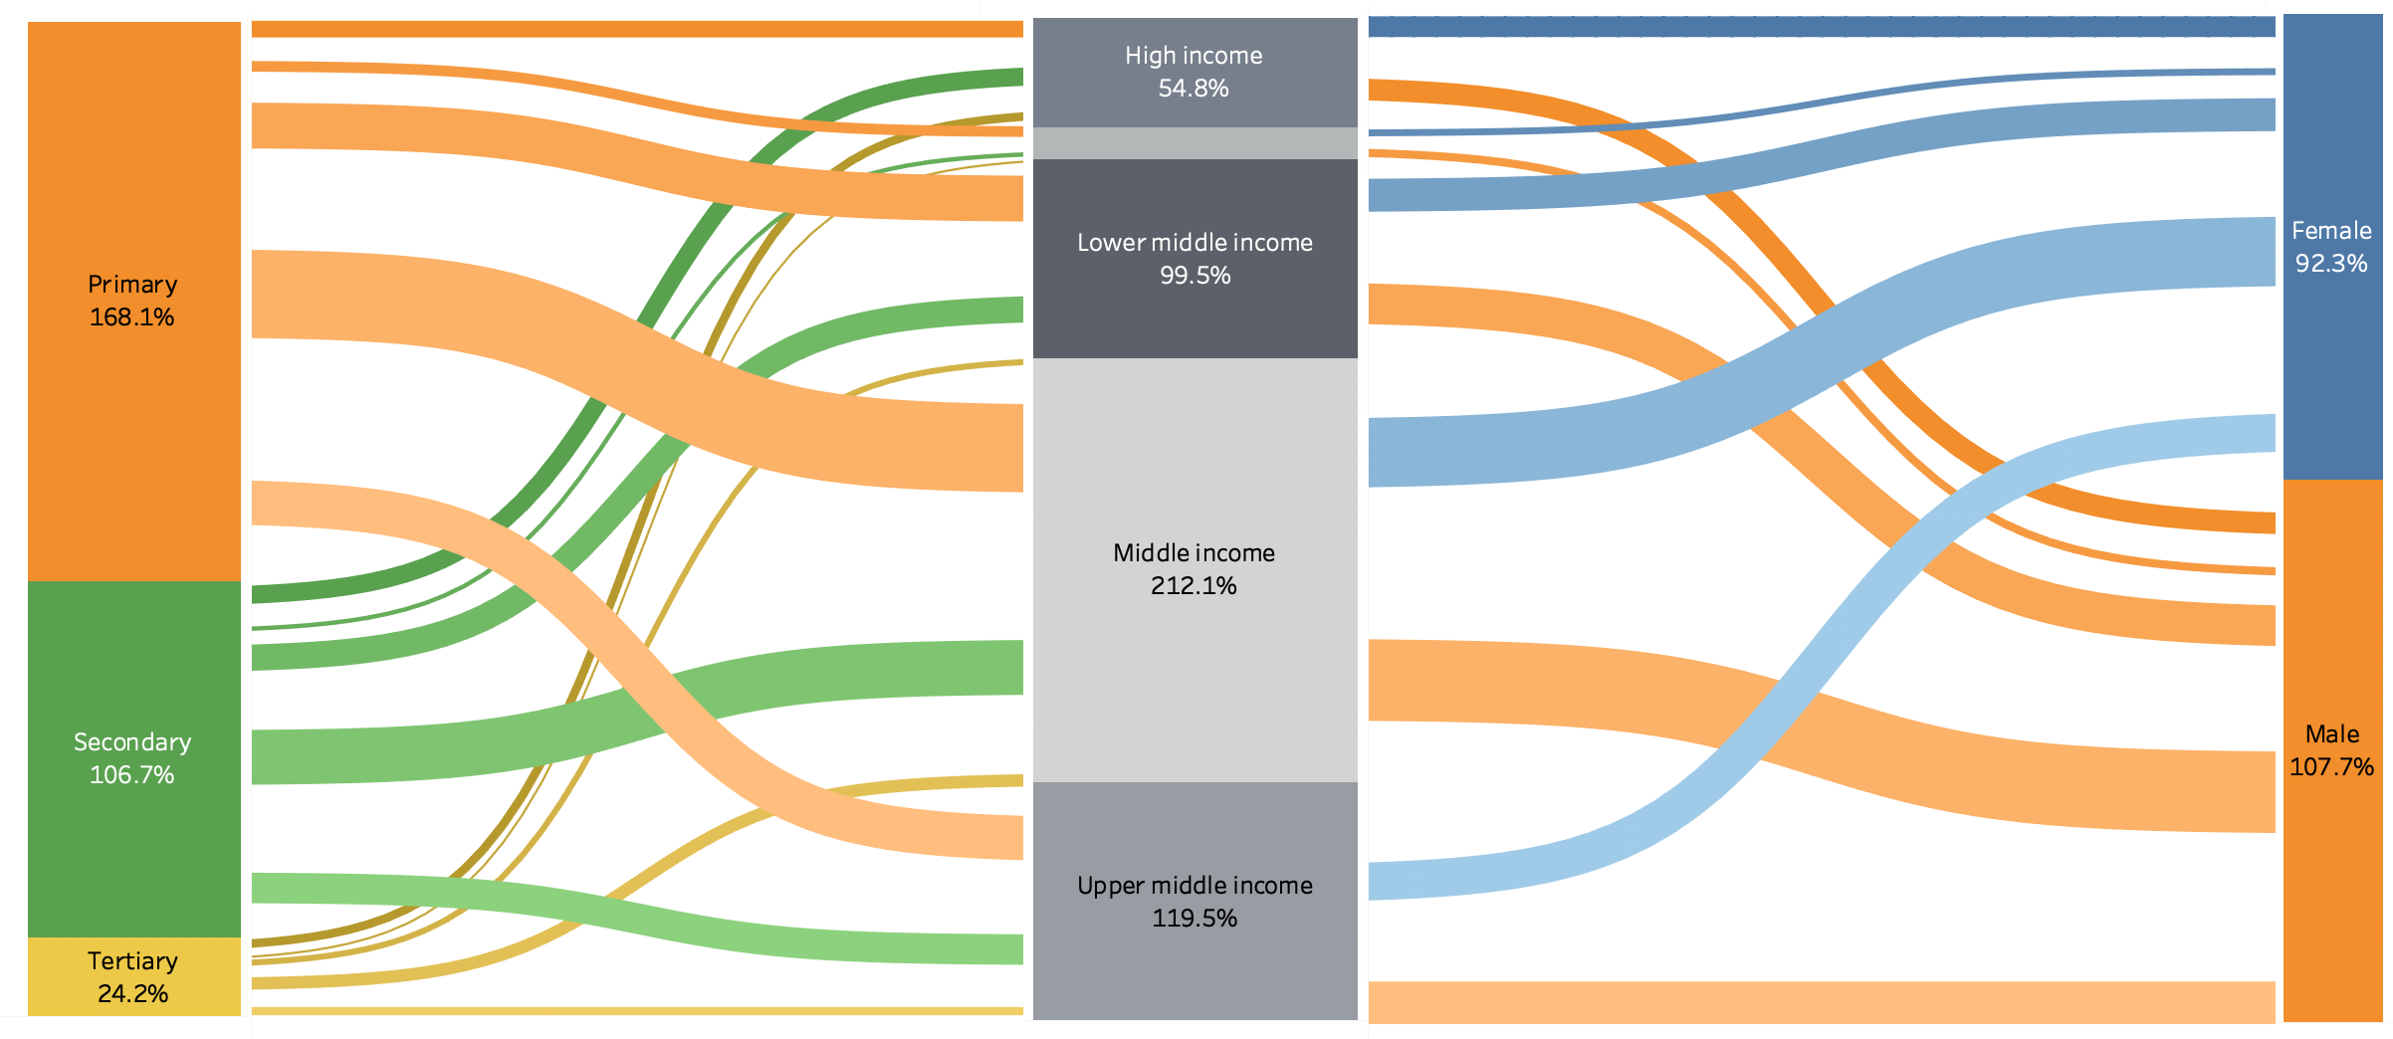
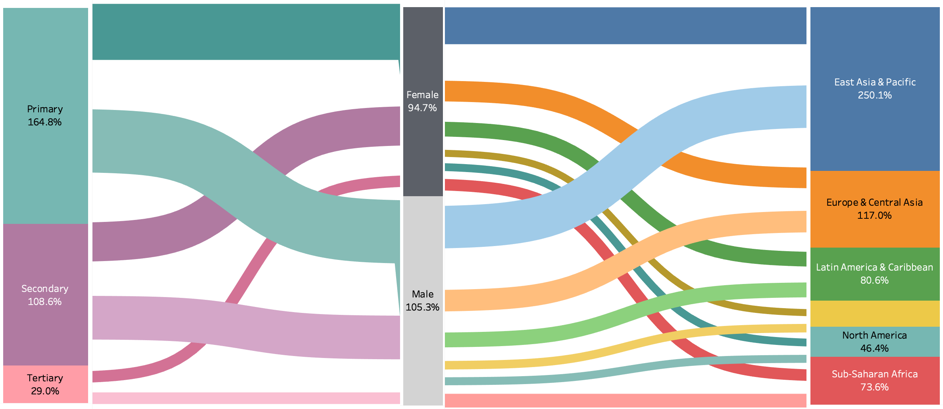
Task 1 - Incorporating Usability Test Feedback
Issue Identified In Usability Testing
And give up the Sankey Diagram
“This diagram is not straightforward, and not informative as expected.”

Slide 11
Task 2 - Discover Distributions
Discover geographic distributions of educational opportunities for women at different levels of schooling using key macro outcomes to filter the data.
Subtasks:
Identify Distribution Outliers
Regional Outliers (In Global Scope)
Country Outliers (In Global Scope)
Country Outliers (In Regional Scope)
Identify Regional Similarities
Generate Hypotheses

Slide 12
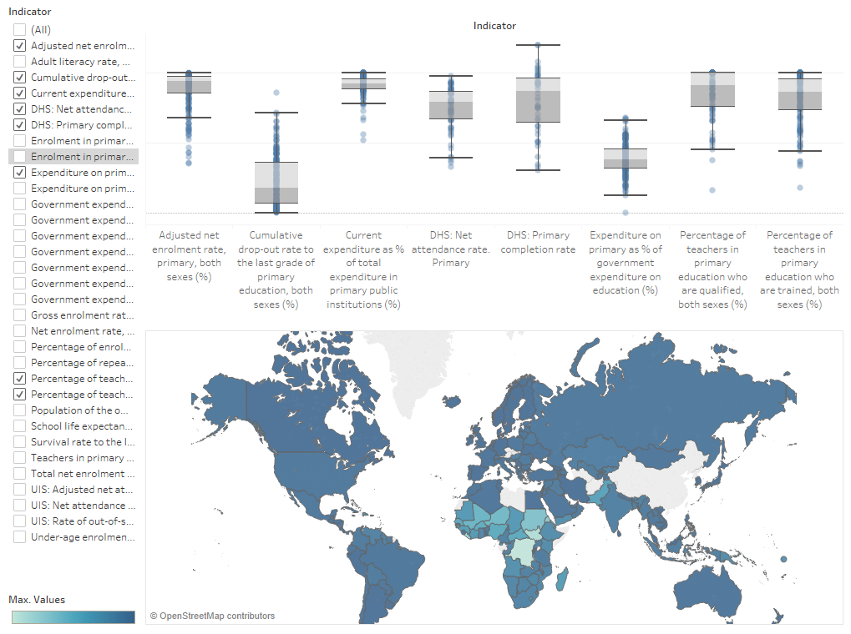
Task 2 - Early Concept - Task Recap
Unlinked dynamic visualizations
Allows users to select desired indicators and brush over regions of interest
Current
Iteration
Reversible linked highlighting
Select region on map to discover regional outliers on box plots
Brush box plots to see if outlying regions exist
Future
Iterations

Slide 13
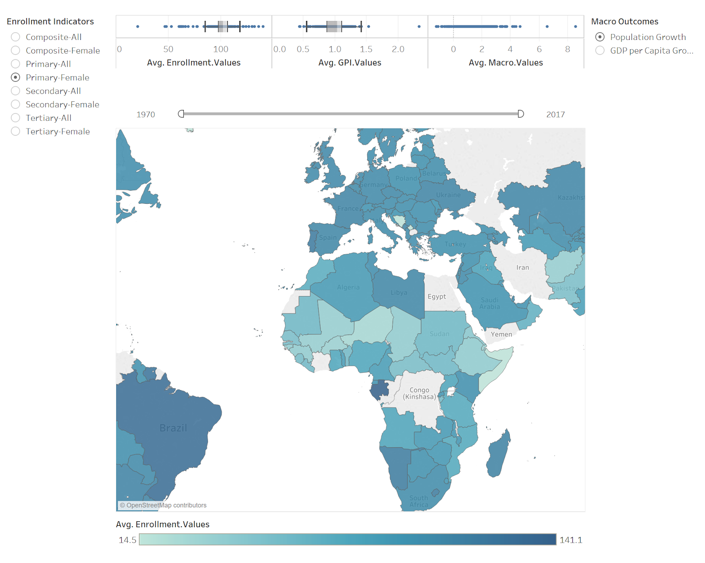
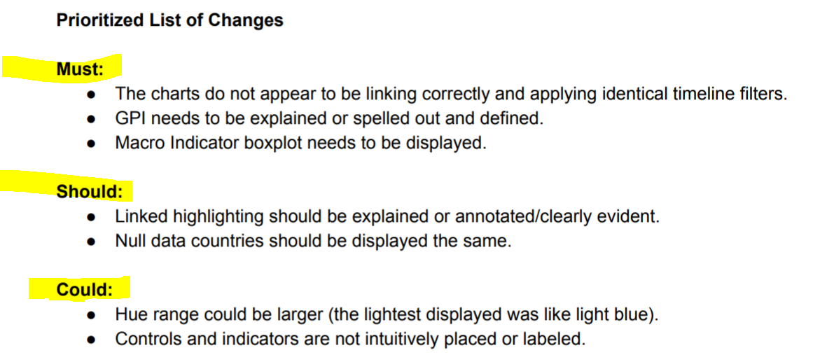
Task 2 - Incorporating Usability Test Feedback

Slide 14
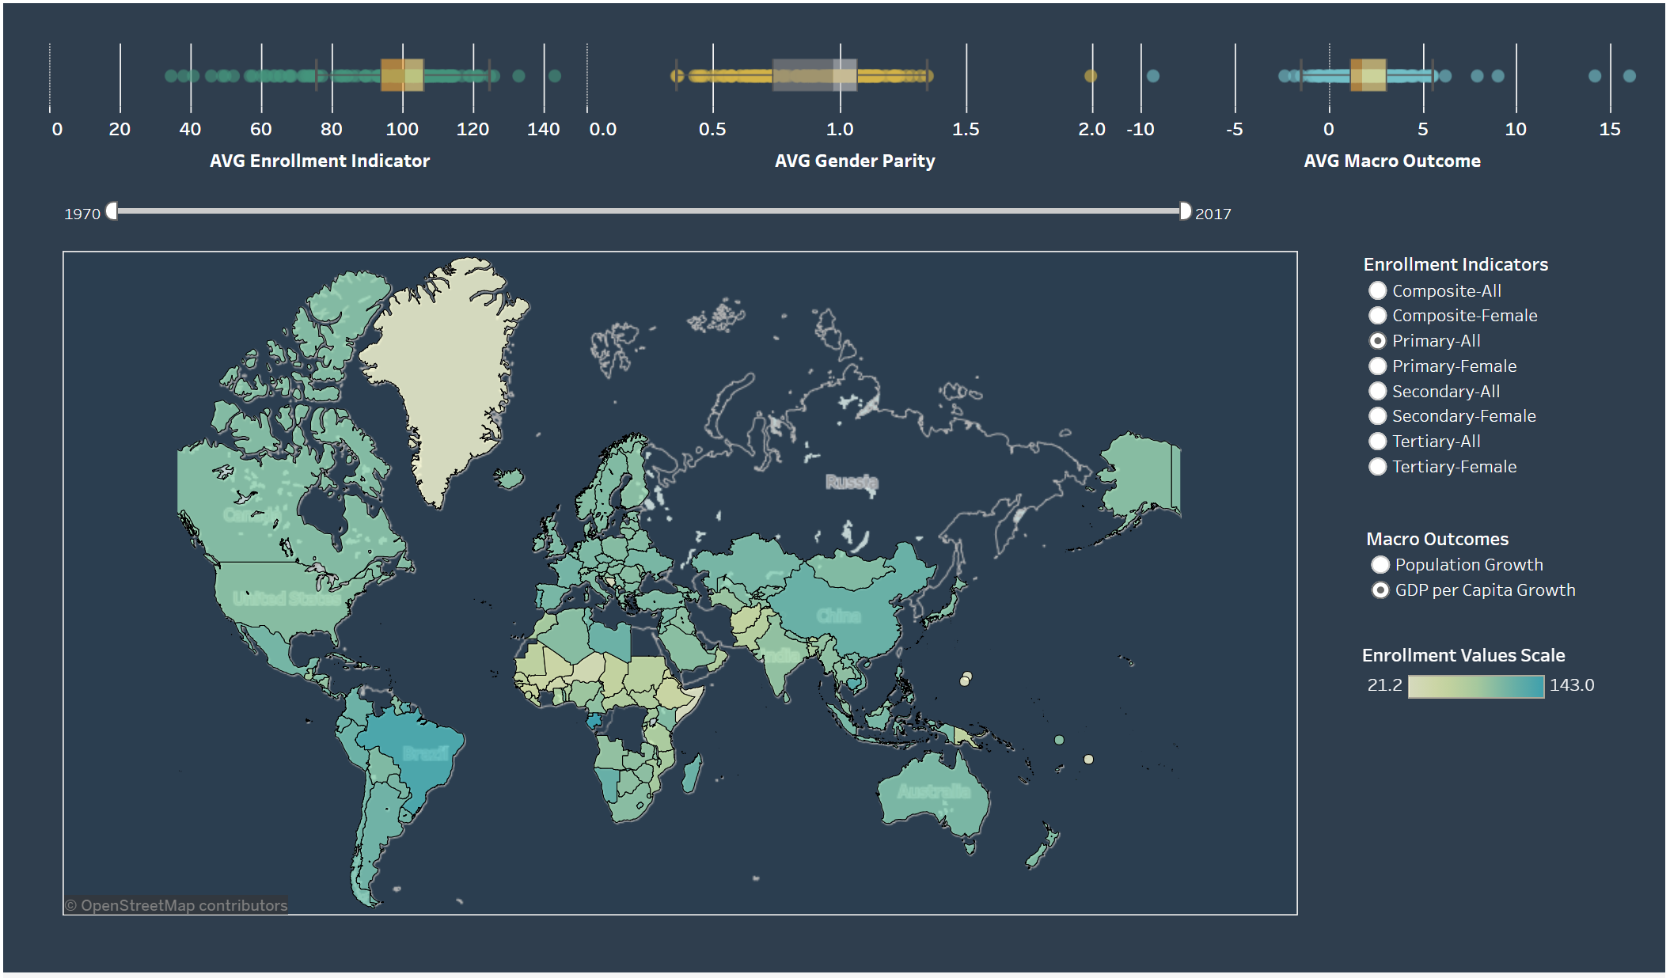
Task 2 - Evolution to Final Product
Implemented changes from “Future Iterations”
Narrowing of scope to female education
Simplification of UI
Explanation of controls
Integrated color scheme
Major Changes

Slide 15
Task 3 - Explore Relationships
Explore relationships between enrollment measures and macro outcomes
Subtasks:
Identify outliers/countries of interest to examine in greater detail (Task 4)
Identify enrollment measures that have the greatest impact on specific macro outcomes
Compare enrollment measure | macro outcome relationship
by geographic region | income group
Locate specific countries of interest and retrieve details

Slide 16
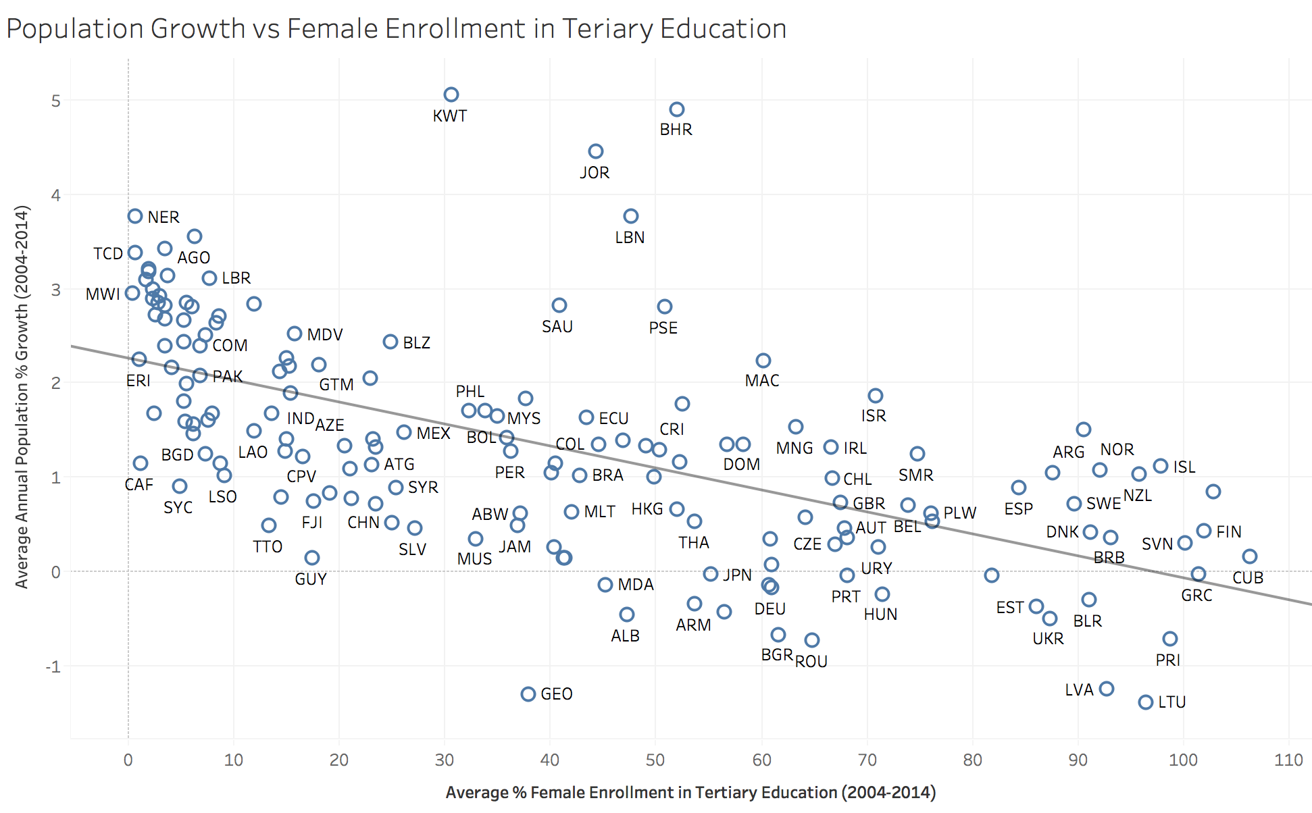
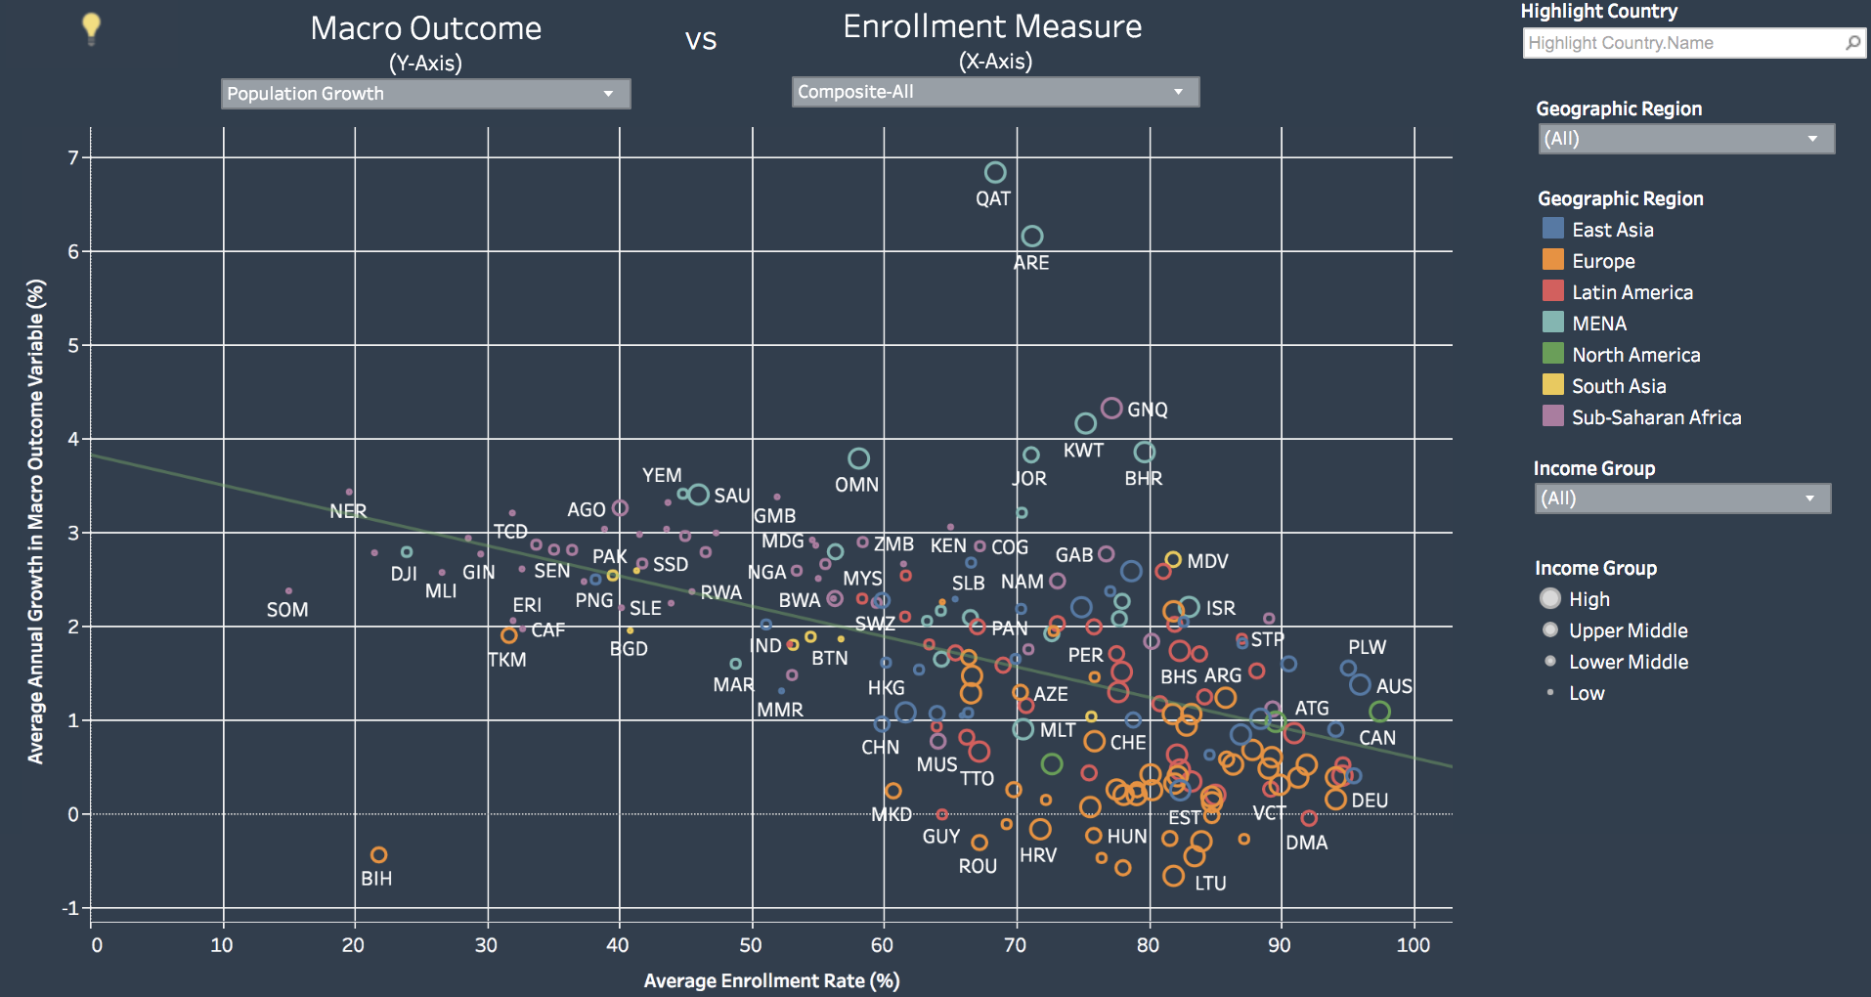
Task 3 - Evolution to Final Product
Allow users to dynamically select enrollment measures and macro outcome variables
Filtering by Region and/or Income Group
Highlight by Region or Income Group
Details on Demand
Prior
Iteration
Static Visualization
Final
Product

Slide 17
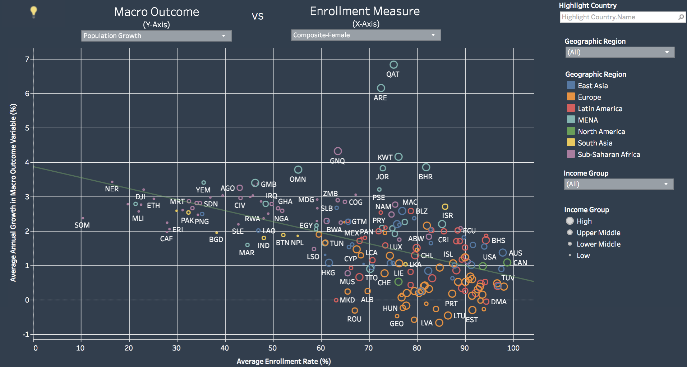
Task 3 - Use Case: Testing Hypotheses
User Hypothesis
Higher levels of female educational attainment, as measured by enrollment rates, are associated with lower population growth
Insight
“Problem” countries concentrated in Sub-Saharan Africa and South Asia
Insights Lead to
New Lines of Inquiry
Do higher female enrollment rates lead to higher economic growth?
Is the effect as strong as it is for population growth?
Which enrollment measure has the strongest impact on population growth?
Insight
Confirmed Hypothesis

Slide 18
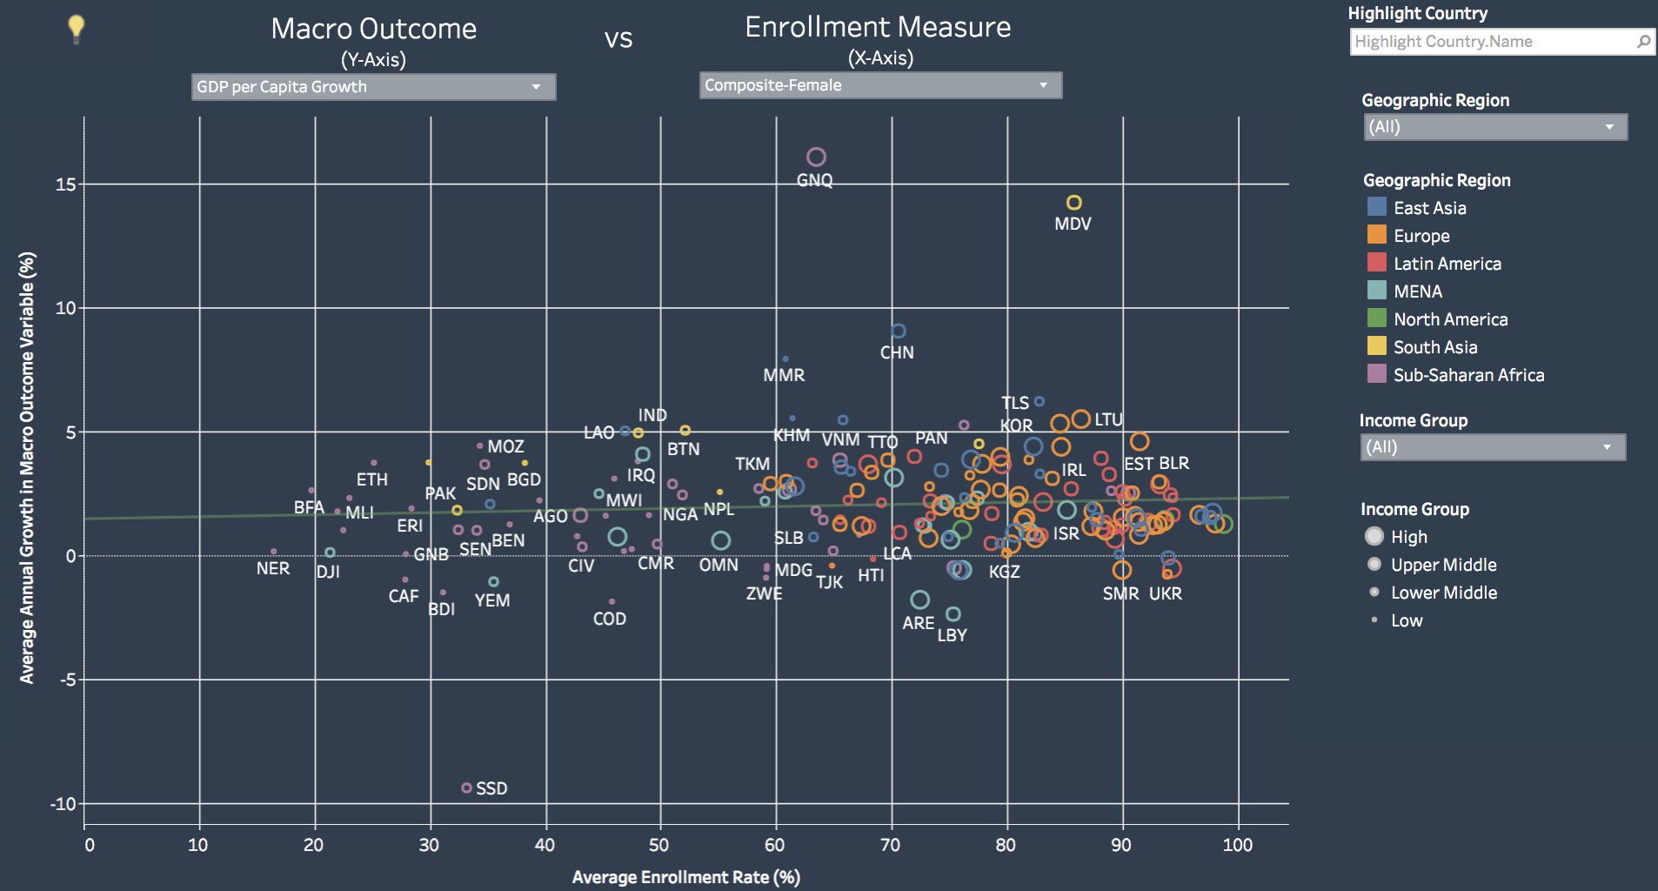
Task 3 - Use Case: Investigating New Lines of Inquiry
Insight
Female enrollment also has a positive impact on per Capita GDP growth, but the effect is much less pronounced relative to its impact on population growth
Do higher female enrollment rates lead to higher economic growth?
Is the effect as strong as it is for population growth?

Slide 19
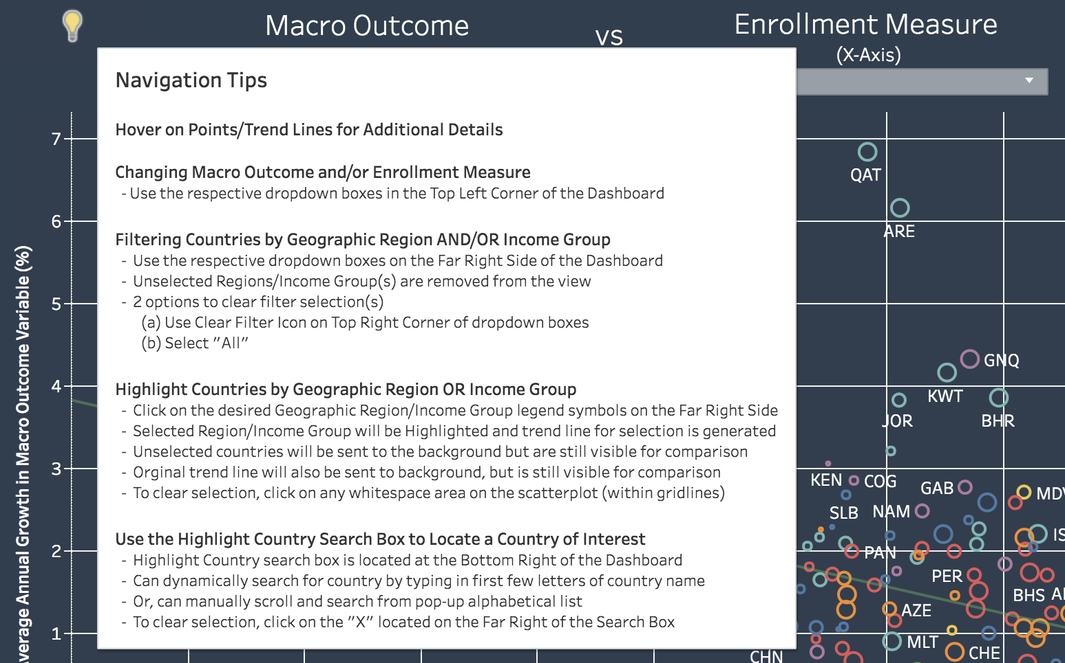
Task 3 - Incorporating Usability Test Feedback
How Issue was Addressed
Priority Issue Identified In Usability Testing
“Add explanatory text that provides an overview of the visualization’s interactive features and basic instructions on how best to use them.”
Notes:
Added Hover Text Help Icon (Navigation Tips)

Slide 20
Task 4 - Explore trends
Analyze and compare trends of key education indicators and key macroeconomic and demographic measures
Subtasks:
Identify trends in education indicators vs macroeconomic/demographic measures for a specific country over time
Compare trends for different countries

Slide 21
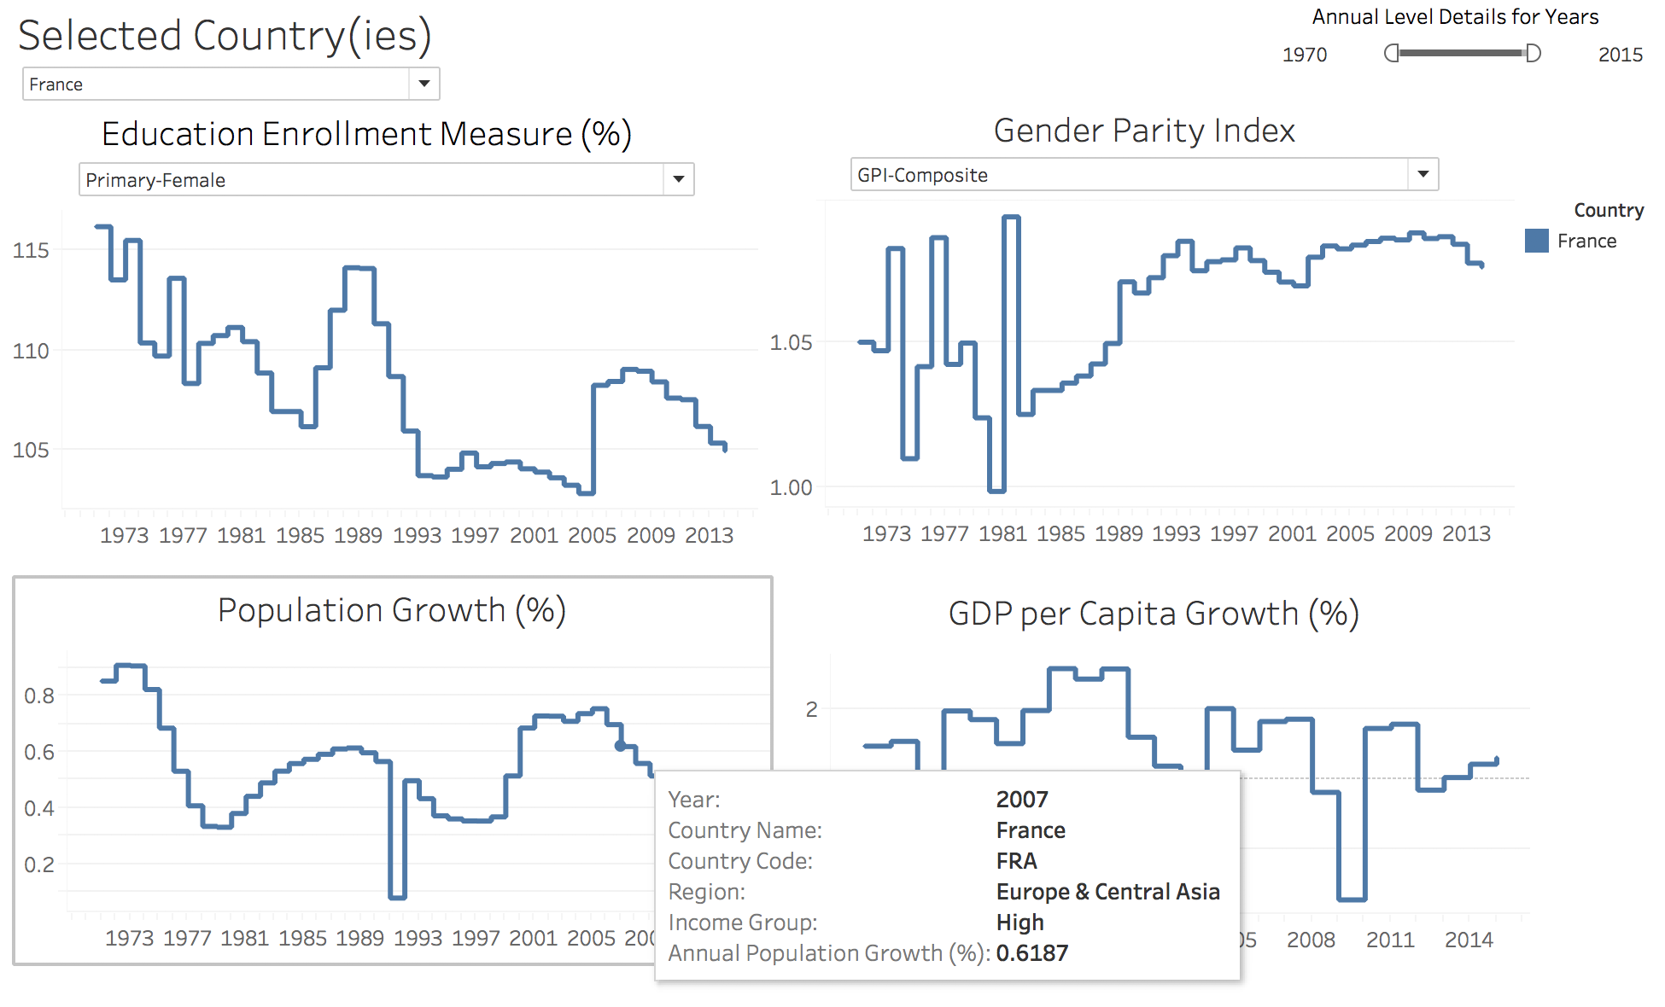
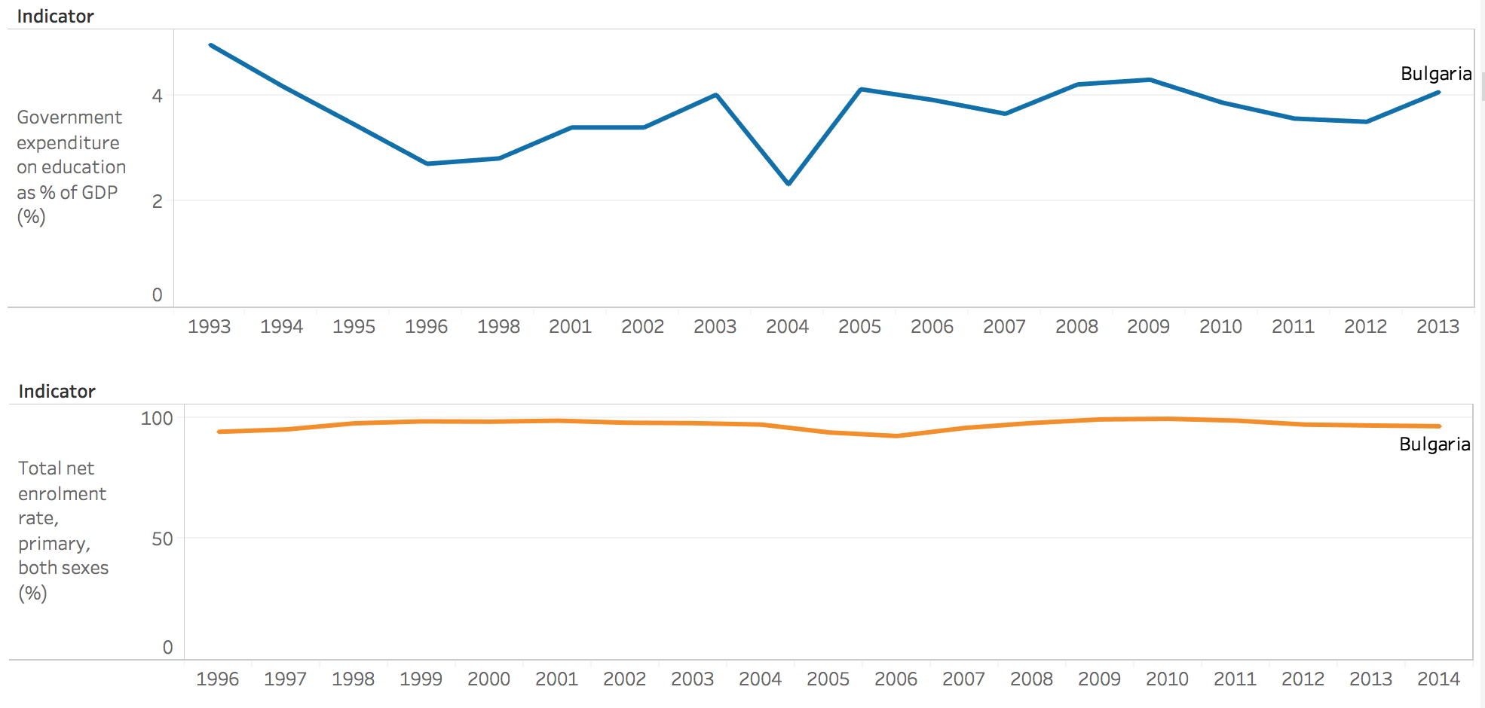
Task 4 - Evolution to Final Product
Manual selection from vast number of Indicators
Final
Product
Select a country or countries to explore or compare trends
Explore trends for various indicators
Details on demand
Prior
Iteration

Slide 22
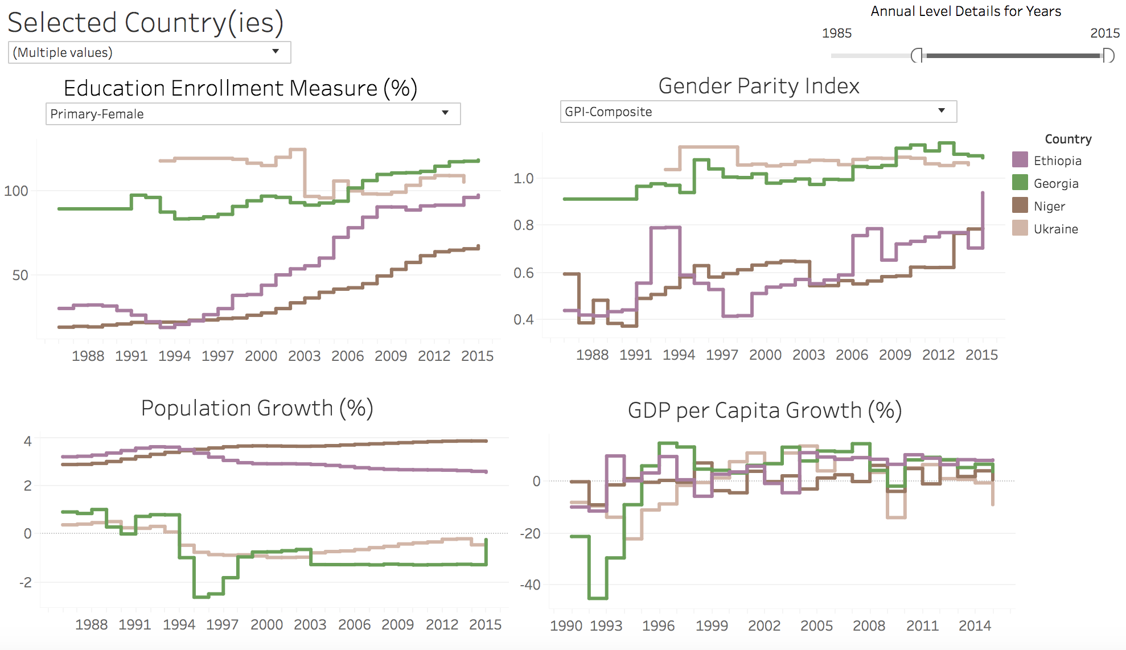
Task 4 - Insights
Insight 1
Female enrollment rate and gender parity are improving in Low and Low-Middle income countries over time
Insight 2
High-income countries have high enrollment rates over the years and they have been able to sustain these rates

Slide 23
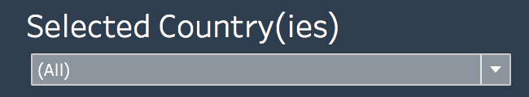
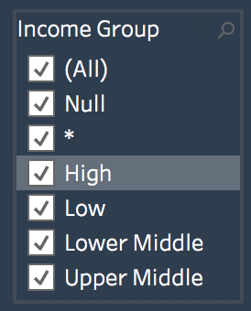
Task 3 - Incorporating Usability Test Feedback
Must:
1. Narrowed down from 100+ indicators to female education and gender parity related metrics.
2. Income Group filter removed, to avoid resetting the Country filter.
3. Removed propagating filter from Task 3 and added Country dropdown menu.
Could:
Graphs for population growth for male and female indicators
not enough data points
Notes:
Added Hover Text Help Icon (Navigation Tips)

Slide 24

Q&A
Please send feedback to: charlene.chen@berkeley.edu

